Slide 1
Presentation Title Goes Here
Presenter’s Name
Presenter’s Title, etc.
Event name and date

Slide 2
This is a test push without VPN

Slide 3
This is a test push with VPN

Slide 4
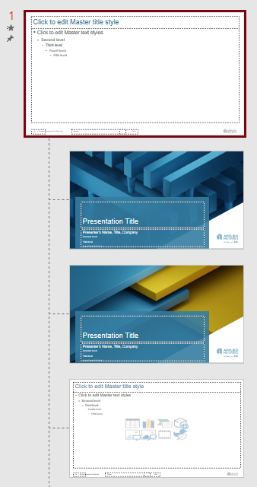
Remember to Use the Correct IP Label
Applied Materials External | Information that can be disclosed or made available outside the company without restriction and has no risk to the company if it ends up in the public domain
Applied Materials Confidential | Information that may be disclosed or made available on a need-to-know basis to the general employee and contingent worker population as well as recipients with a nondisclosure agreement or confidentiality obligation to the company in effect but must not be made publicly available. Applied Materials Confidential information should only be shared with customers when clearly marked for customer use.
Applied Materials Confidential Limited Access / [Required Modifier] | Information that can only be disclosed or made available to a select group of employees and recipients with a nondisclosure agreement or confidentiality obligation to the company in effect with a need to know the information. The required modifier provides further clarity regarding the need-to-know intended viewership. Example of modifiers include descriptors such as Internal Use Only, a Group Name, or a Third Party Name for confidential information received from a customer, supplier, or other third party subject to a contract or other legal obligation (defined by the terms of the contract with the external party or identifying the owner of embedded confidential information).
1
| Applied Materials Confidential
For additional information type “vip/” into your browser. Select Labeling
How to Change IP Labeling
From the View tab, select Normal presentation view
Select Slide Master view. This will take you to the current slide layout
On the left hand panel, scroll up and click on the Slide Master
Modify the IP labeling. This will change the IP labeling on the all associated slide layouts EXCEPT the title pages
From the View tab, select the slide layout for the title page in your presentation and modify the IP labeling
Slide Master
Slide Layouts

Slide 5
Special Characters and Scientific Notations
Arial text font
• Alt+0149 ° Alt+0176
± Alt+0177 Å Alt+0197
µ Alt+0181 ß Alt+0223
¼ Alt+0188 ½ Alt+0189
¾ Alt+0190 — Alt+0151
– Alt+0150 £ Alt+0163
™ Alt+0153 ® Alt+0174
¹ Alt+0185 ² Alt+0178
³ Alt+0179 ç Alt+0231
é Alt+0233 © Alt+0169
Symbol text font
α Key a β Key b
χ Key c δ Key d
ε Key e φ Key f
γ Key g η Key h
ι Key i ϕ Key j
κ Key k λ Key l
μ Key m ν Key n
π Key p θ Key q
ρ Key r σ Key s
τ Key t υ Key u
ω Key w ξ Key x
Σ Key S Ω Key W
Windings text font
n Key n x Alt+0253
ü Alt+0252 þ Alt+0254
¡ Alt+0161 û Alt+0251
More Symbol font
← Alt+0172 → Alt+0174
Alt+0173 ↓ Alt+0175
÷ Alt+0184 ± Alt+0177
≤ Alt+0163 ≥ Alt+0179
≠ Alt+0185 ≈ Alt+0187
≅ Key @ ∑ Alt+0229

